Slide 1
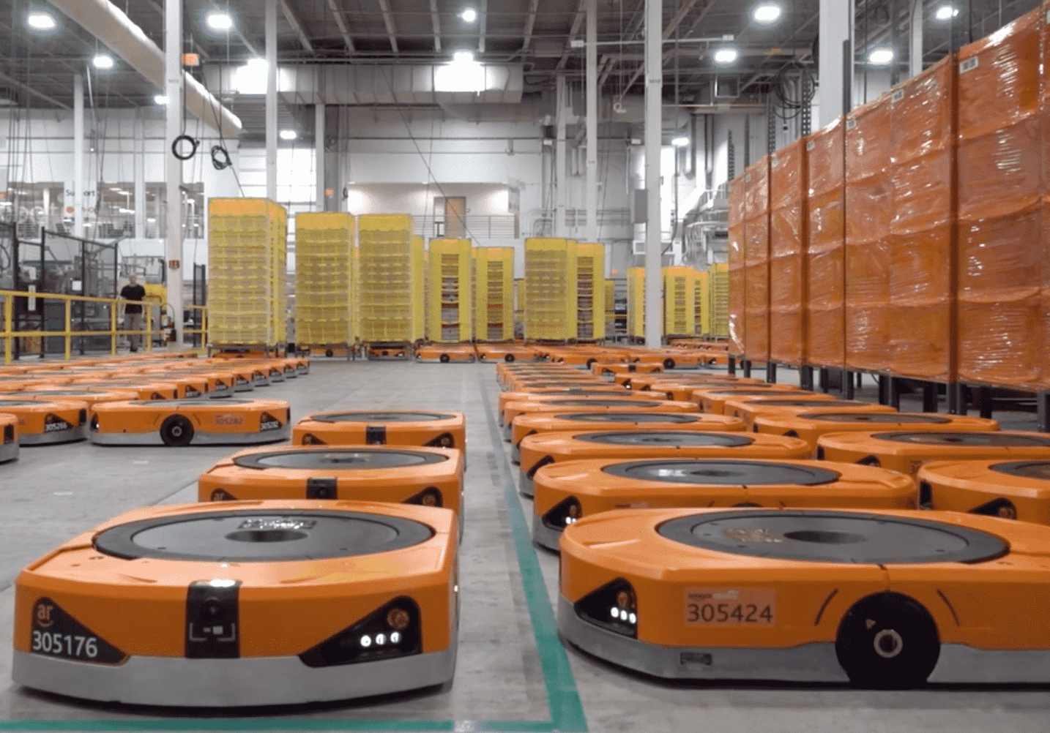
AMAZON WAREHOUSE CASE
Miho Terahata
OPMT 620-33
Ramneek Singh Kumar
March 17, 2025

Slide 2
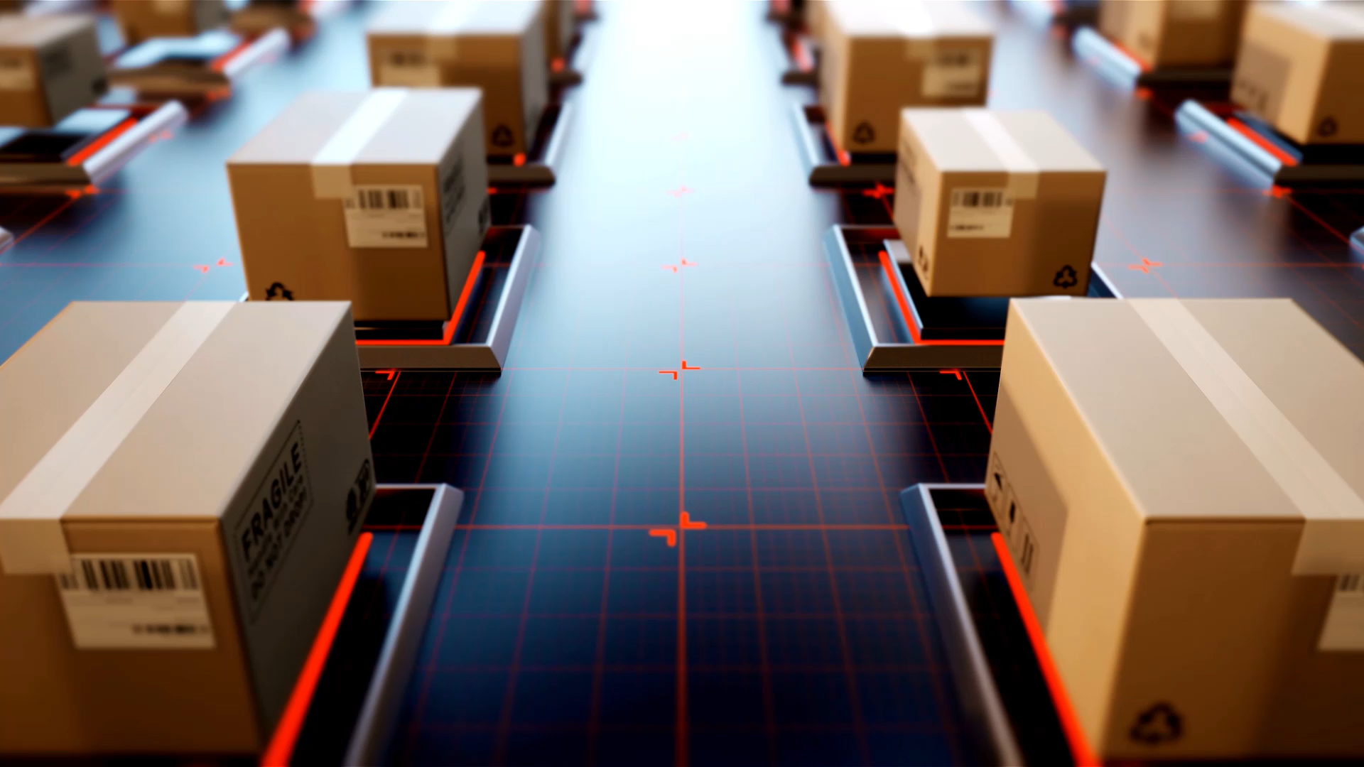
Amazon’s Warehouse Transformation
Addressing Inefficiencies in the Order-Picking Process

Slide 3
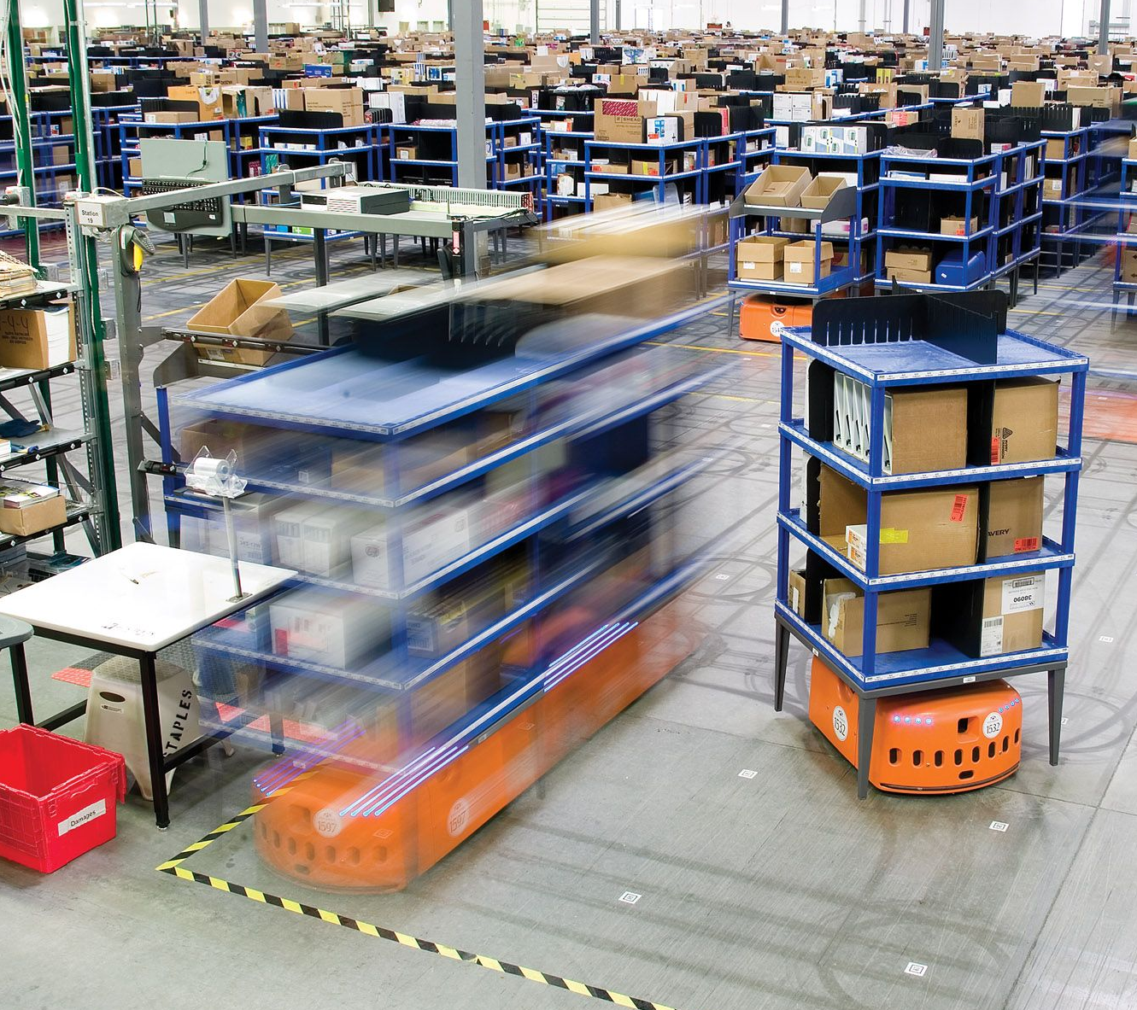
Introduction
Amazon faced inefficiencies in:
Order-picking process
High labor costs
Space constraints
Fulfillment bottlenecks
To address these challenges, Amazon integrated Kiva Robotics, revolutionizing its warehouse operations.

Slide 4
Key Issues
Manual and time-consuming order picking process
High labor costs and workforce management challenges
Inefficient space utilization and storage constraints

Slide 5
Key Issues
Order processing delays and bottlenecks
High error rates in order fulfillment
Physical strain and workplace injuries

Slide 6
Possible Solutions
Hiring New Workers
Building New Fulfillment Centers
Employee Wellness Program
Redesigning Pickup Process
Automation (Jidouka)

Slide 7
Implementation of Robotics in Amazon Warehouses
Enhancing Order Picking and Packing Process

Slide 8
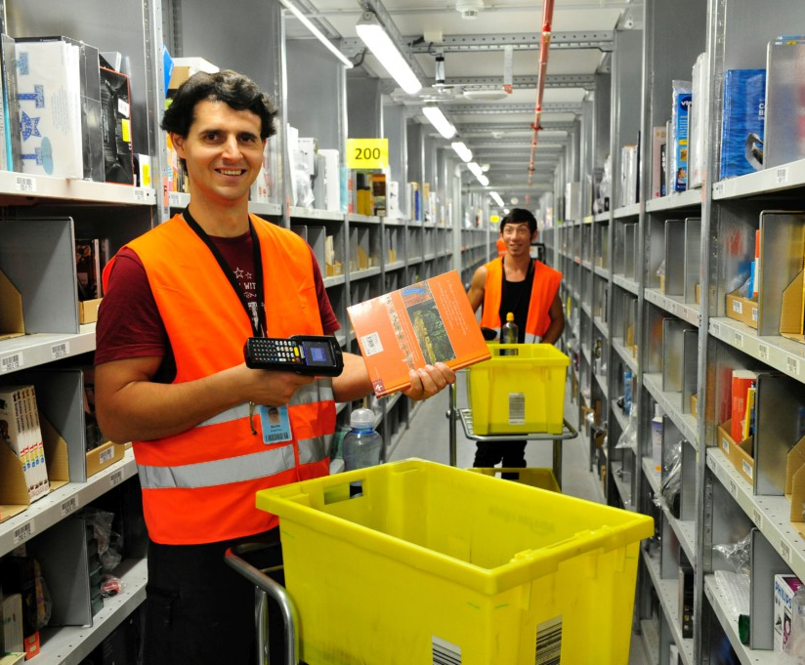
How warehouses worked before the implementation
Amazon receives the items.
The items were picked, scanned and placed on shelves.
Each scanned item would have the information about its location.
When a customer place an order, an employee would have to go to the shelf and take the items.
The worker place the itens in a container and sends to the packing area through a convoyer.

Slide 9
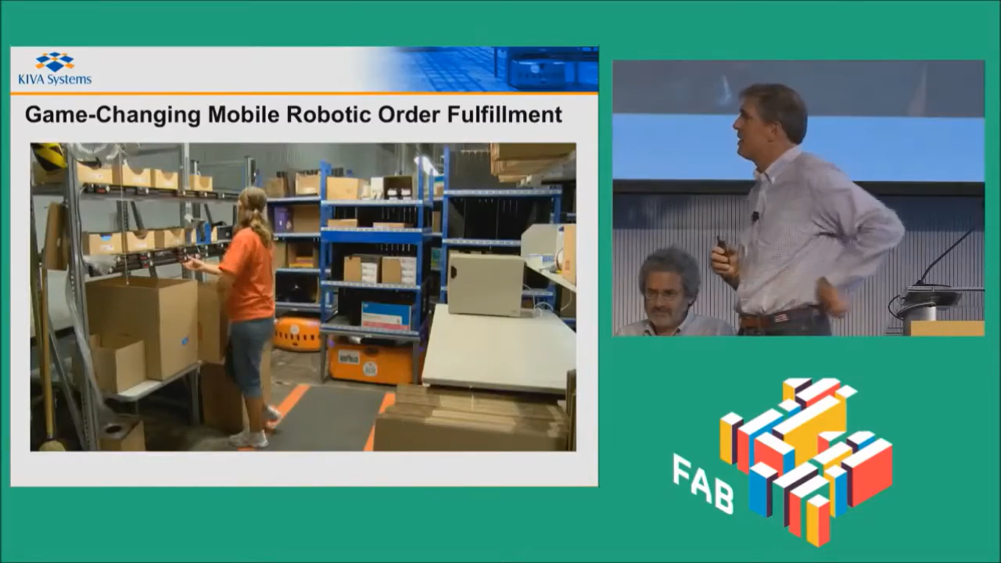
How warehouses work with Kiva Systems
Amazon receives the items.
The items were picked, scanned and placed on movable shelves.
When a customer places an order, the robots bring the movable shelves to the worker.
The worker takes the item, scan it and press a button to send the robot away.
The worker place the itens in a container and sends to the packing area through a convoyer.

Slide 10
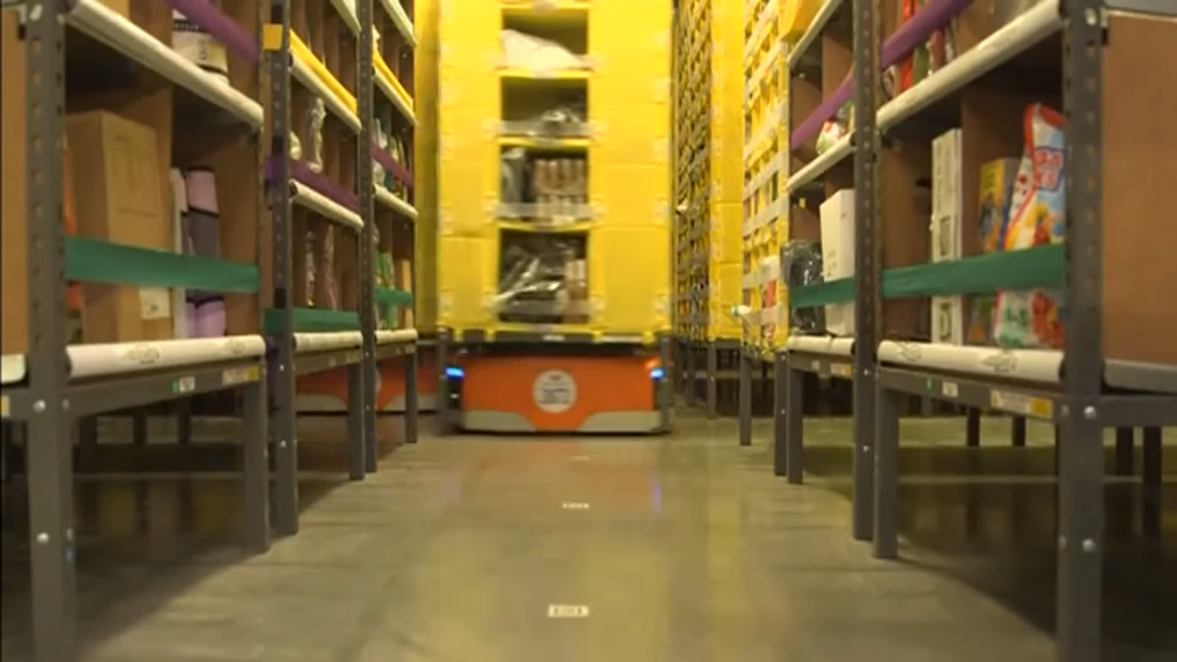
Kiva Robots in Amazon Warehouses
Kiva Robots were introduced in Amazon warehouses for picking and delivering items.
Amazon purchased Kiva Systems in 2012 for $775 million.
Benefits:
Increased processing speed.
Reduced human fatigue.
Improved warehouse space utilization.

Slide 11
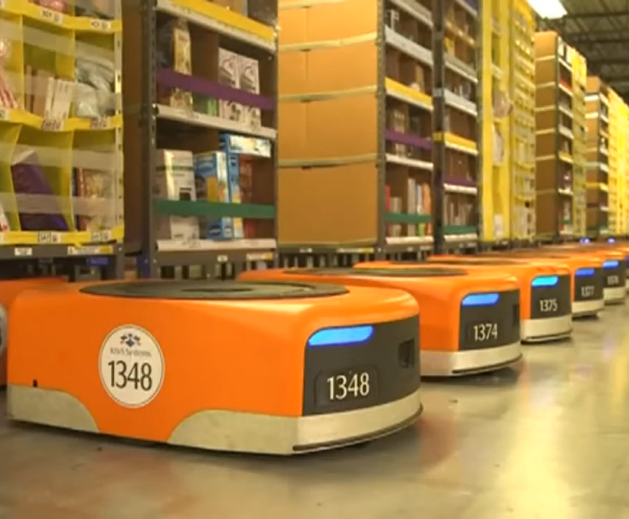
Operational Enhancements After Amazon Robotics
Fulfillment speed increased from 60-75 sec to 15-30 sec.
Walking distance reduced by 75%.
Processing capacity increased to 300-400 orders per hour.
Cost per order reduced by 30%.
Storage space increased by 50%.

Slide 12
Challenges in Implementing Robotics
High Initial Investment
Technical Errors
Regular Maintenance
Risk of operational disruption
Note. The design from Smart Art in PPT.

Slide 13
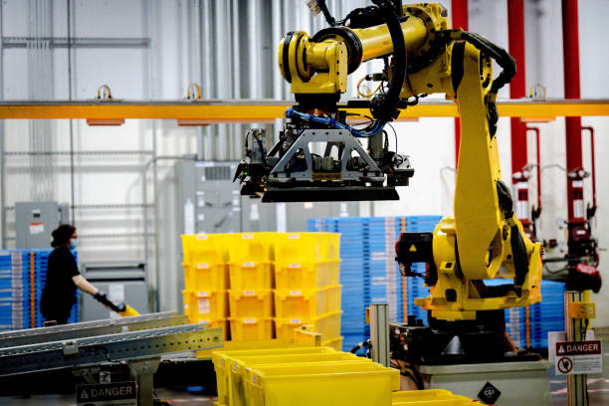
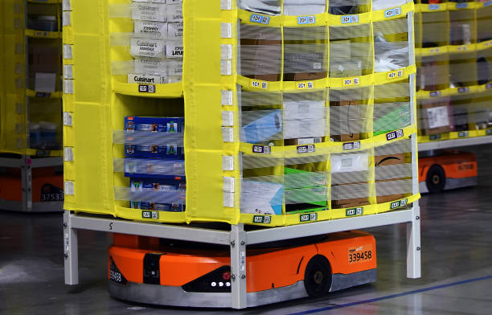
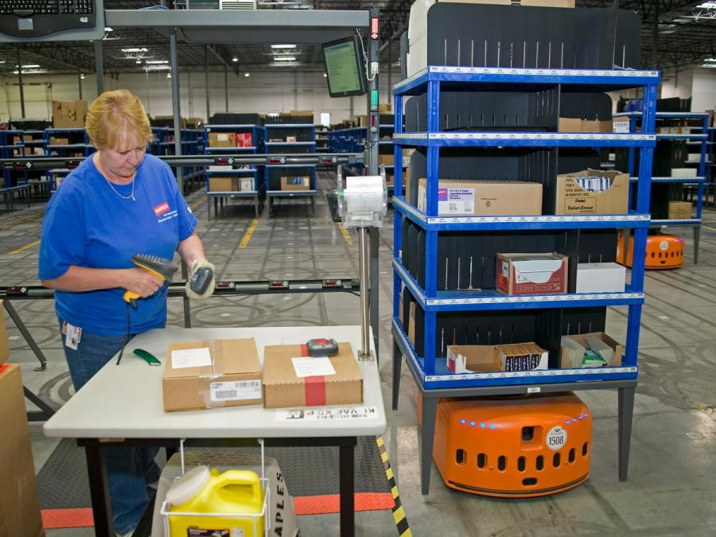
Examples of robots working in Amazon facilities

Slide 14
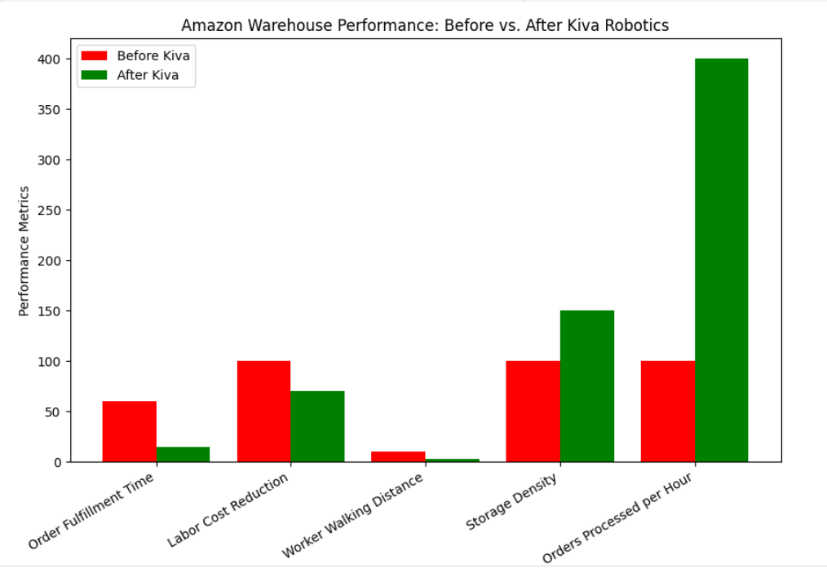
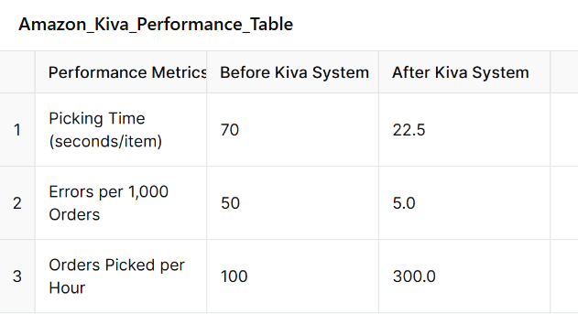
Amazon Warehouse Performance Analysis

Slide 15

Conclusion

Slide 16
References
Acadia, A. (2024, November 28). How Amazon robotics changed the landscape of fulfillment. Exotec. https://www.exotec.com/insights/how-amazon-robotics-has-changed-the-landscape-of-fulfillment/
Chips, J. (2024, January 21). Robotics at Amazon: Prototype to Production (Part 1). Medium. https://justinchips.medium.com/robotics-at-amazon-lessons-learned-from-prototype-to-production-part-1- 22c58537da3c
Guizzo, E. (2022, September 1). Kiva Systems: three engineers, hundreds of robots, one warehouse. IEEE Spectrum. https://spectrum.ieee.org/three-engineers-hundreds-of-robots-one-warehouse
Hammond, G. (2019). The warehouse of the future: Automation and robotics in e-commerce logistics. Supply Chain Management Journal, 12(3), 45-61.
Kumar, A., Sharma, S., & Li, Y. (2020). E-commerce logistics and warehouse automation: A case study of Amazon’s fulfillment centers. Operations Research Review, 18(2), 122-138.

Slide 17
Levy, S. (2019). Inside Amazon: How the world’s largest retailer manages its fulfillment network. Logistics and Distribution Quarterly, 27(4), 95-110.
Manners-Bell, J. (2017). Logistics and supply chain innovation: The case of Amazon’s fulfillment strategy. International Journal of Logistics Studies, 9(1), 33-49.
Meraj, T. (2023, March 3). Amazon Inventory Management Problems & Consequences of Poor Inventory Management. Kenjiroi. Retrieved from https://kenjiroi.com/amazon-inventory-management-problems-consequences-of-poor- inventory-management/
McKinsey & Company. (2017). The future of warehouse automation: Trends and challenges in global supply chains. McKinsey Report, 11(5), 67-89.

Slide 18
Mountz, M. (2012). Amazon acquires Kiva Systems for $775 million. Kiva Systems Official Release.
Staff, A. (2022, June 21). Look back on 10 years of Amazon robotics. https://www.aboutamazon.com/news/operations/10-years-of-amazon-robotics-how-robots-help-sort-packages-move- product-and-improve-safety
Staff, A. (2022, June 21). Look back on 10 years of Amazon robotics. https://www.aboutamazon.com/news/operations/10-years-of-amazon-robotics-how-robots-help-sort-packages-move-product-and-improve-safety
Wulfraat, M. (2014). Amazon’s fulfillment transformation: The impact of robotics on e-commerce logistics. Modern Logistics Journal, 10(2), 55-72.

Slide 19
Visual references
Admin. (2022, July 2). Amazon launches a fully autonomous warehouse robot. Tycoon Success. https://tycoonsuccess.com/amazon-launches-a-fully-autonomous-warehouse-robot/
AllAboutLean (2019). Amazon manual picking. https://www.allaboutlean.com/amazon-fulfillment- 1/amazon-fc-graben-foto-marcus-schlaf-24-07-2014/
Brown, A. S. (2022, December 2). How Amazon robots navigate congestion - Amazon Science.
Amazon Science. https://www.amazon.science/latest-news/how-amazon-robots-navigate- congestion
Foundation Models (2015). How Amazon Robots work [Video].Youtube. https://www.youtube.com/watch?v=tZwlXW9AiDA

Slide 20
Guizzo, E. (2008). KIVA SYSTEMS: THREE ENGINEERS, HUNDREDS OF ROBOTS, ONE WAREHOUSE. IEEE Spectrum. https://spectrum.ieee.org/three-engineers-hundreds-of-robots-one- warehouse. https://www.youtube.com/watch?v=ULswQgd73Tc
IA-ROBOTIQUE-MATHS - 6ème (2017). Robots Kiva : Amazon [Video].Youtube.
Waredock (n.d.). What is Amazon Robotic Fulfillment Center? https://www.waredock.com/magazine/what- is-amazon-robotic-fulfillment-center/
Visual references

Slide 21
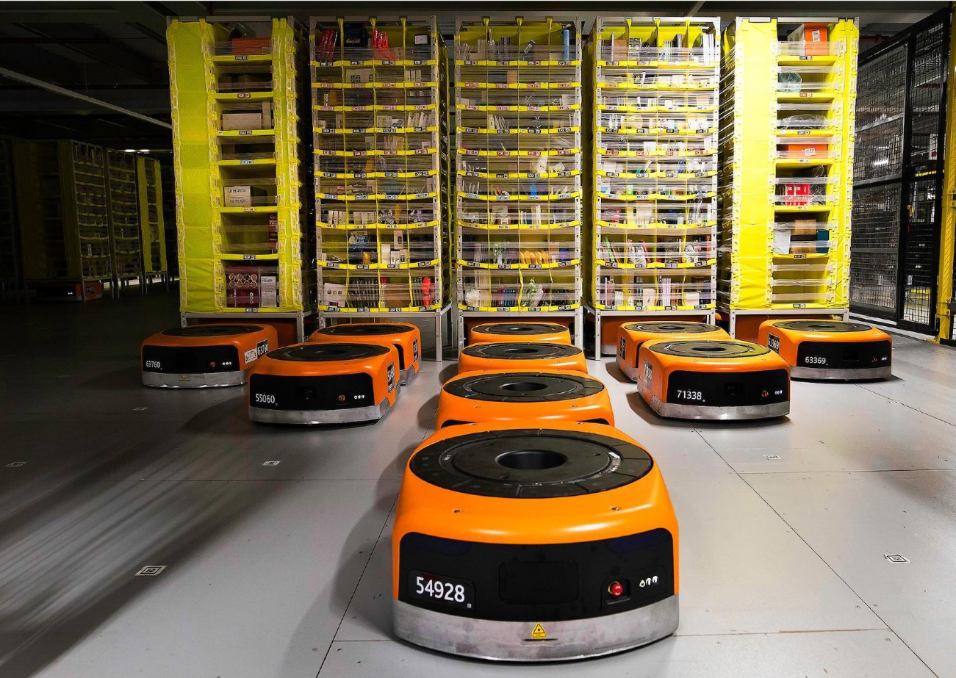
Thank you!

